Slide 1

Online Safety
Information EvenT
Parenting in the Digital Age
Keeping Your Child Safe
ONLINE

Slide 2

Welcome
Goals for the Session
To understand what our children
are doing online
To keep our children safe when
they’re online
To teach our children to make smart choices when they’re online
To start a discussion about Online safety that we continue with our families and others beyond today

Slide 3
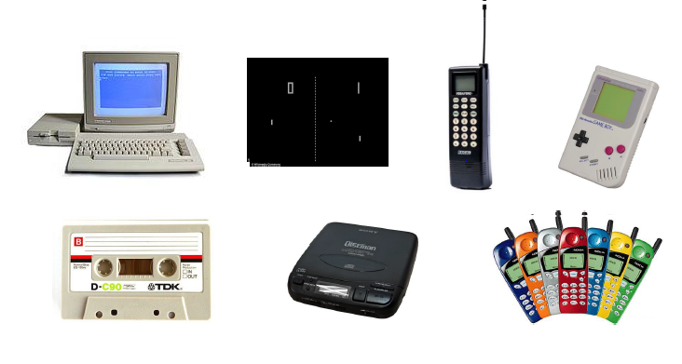
“My kids know more about the internet than I do…..”
https://www.youtube.com/watch?v=ytcAf2-yIFc

Slide 4
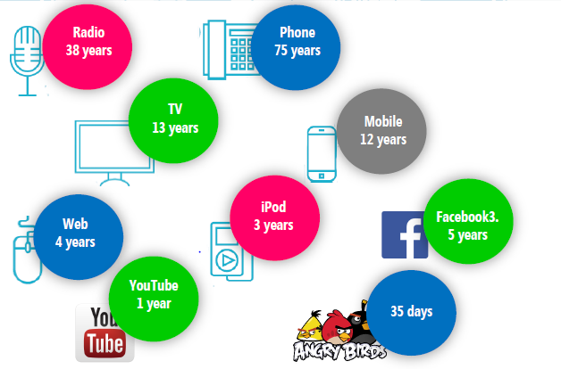

Penetration rate: Years to reach c.50m users

Slide 5
What children do online…..
Visit virtual worlds
Play multiuser games
Text or instant message
one another
Post profiles and interact
with others on social
networking sites
View and post videos
Download music, movies,
and more
Create and upload art
Do research

Slide 6
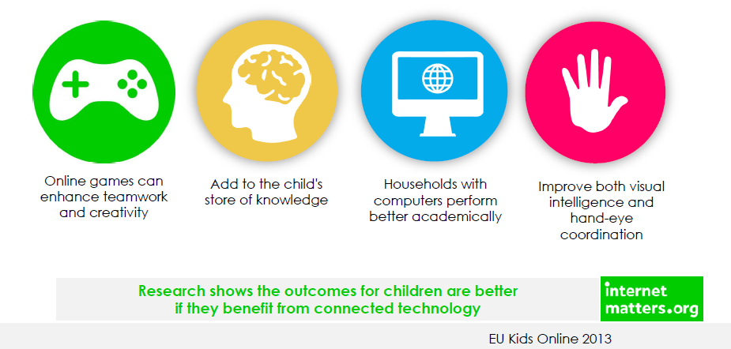
There are lots of positives….

Slide 7
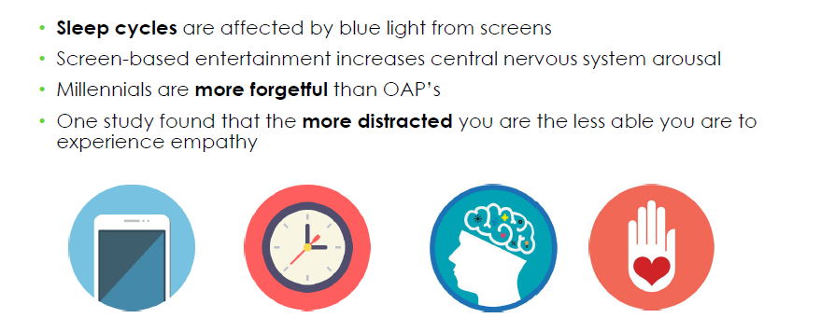
But technology can affect children’s development

Slide 8
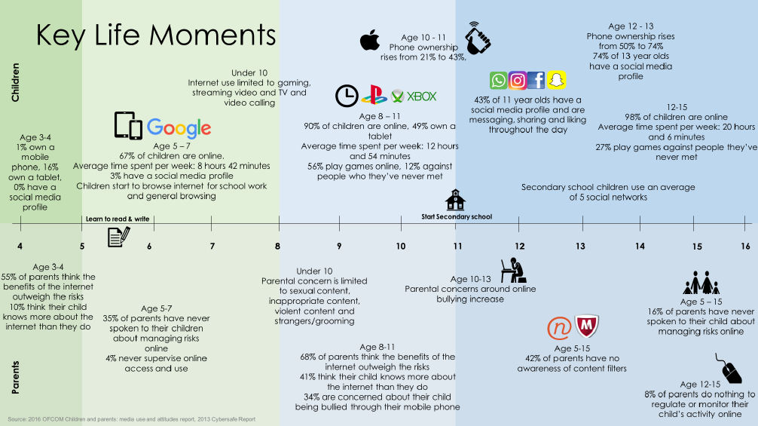

Slide 9
And there are of course risks…..
Cyberbullying
Disturbing content
Viruses and spyware
Sexual predators
Personal data misuse
Sexual harassment ‘sexting’
https://www.youtube.com/watch?v=-IOOn2wR8bU

Slide 10
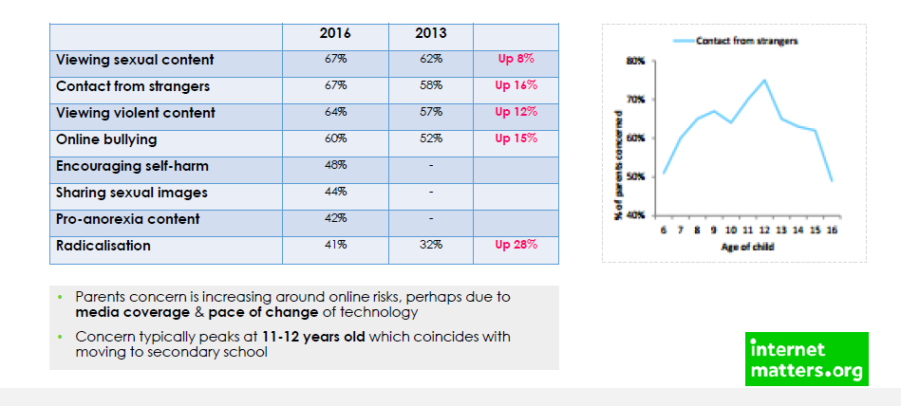
Risks parents are concerned about

Slide 11
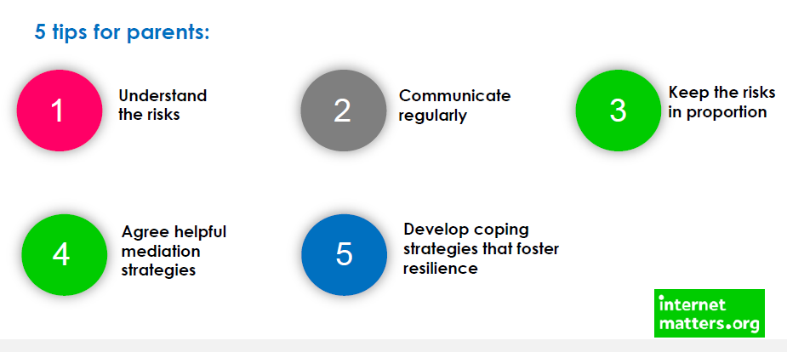
Risk is not harm. Positive action can limit risks becoming harmful

Slide 12
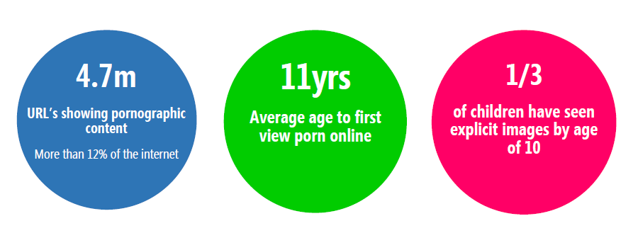
Dealing with inappropriate CONTENT

Slide 13

Dealing with inappropriate CONTENT
What to talk about
They can come to you if they see anything that upsets them
If they have seen pornography…that it presents an unrealistic image of sex and relationships
The importance of respect for each other and the meaning of consent
Top tips / tools to use
Parental controls on home broadband
Content lock on mobile networks
Safe search on Google (& other browsers) & YouTube; child –friendly search engines

Slide 14


Inappropriate CONTENT
There are “bad” parts of the Internet, just as there are “bad” parts of town.
Shield your child with:
  parental control software
  child-friendly search engines
  bookmarks to favorite sites
Teach your child what to do if he/She accidentally views disturbing content.
https://www.kiddle.co/
https://swiggle.org.uk/

Slide 15
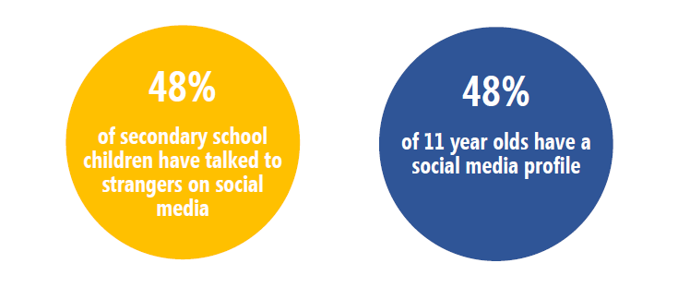
Dealing with inappropriate CONTACT

Slide 16

Dealing with inappropriate CONTACT
What to talk about
Sometimes people hide behind fake profiles for dishonest reasons
Agree how they will respond to requests from people they don’t know in real life
Never ever to meet up with anyone they don’t know in real life
Top tips / tools to use
Set up safe social media profiles that don’t share personal information
Turn off geo location settings on devices
Use the strongest privacy settings on social media
Learn how to report / block/ mute

Slide 17
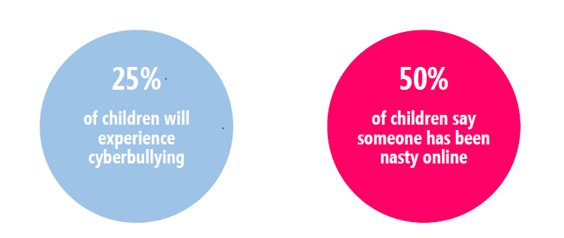
Dealing with inappropriate CONDUCT

Slide 18
Cyberbullying
Posting or forwarding a private text
or embarrassing image to others
Tricking someone into revealing embarrassing information and forwarding it to others
Spreading malicious rumors
Stealing passwords

Slide 19
Protecting Against Cyberbullying
Never respond to unkind remarks.
Don’t participate in cyberbullying.
Block the cyberbully.
Tell a trusted adult.
Save the posts.
Notify law enforcement, if appropriate.
Notify your child’s school, if appropriate.

Slide 20
Dealing with inappropriate CONDUCT
What to talk about
Talk to a trusted adult if they experience anything upsetting online
Think carefully about sharing images of others
Be responsible online, remembering they are creating their own digital footprint
Top tips / tools to use
Report inappropriate posts/content to the social media providers
Think carefully about using monitoring apps that identify inappropriate behaviour

Slide 21
Sexual Predators
Masquerade as other children or kindly adults
Trick children into revealing personal information
Lure children and teenagers into meeting them in person

Slide 22

Keep personal information private…..
Never reveal:
  Name
  Address
  Phone number
  School name
Don’t post or send photographs of yourself.
Choose a nondescript screen name.

Slide 23
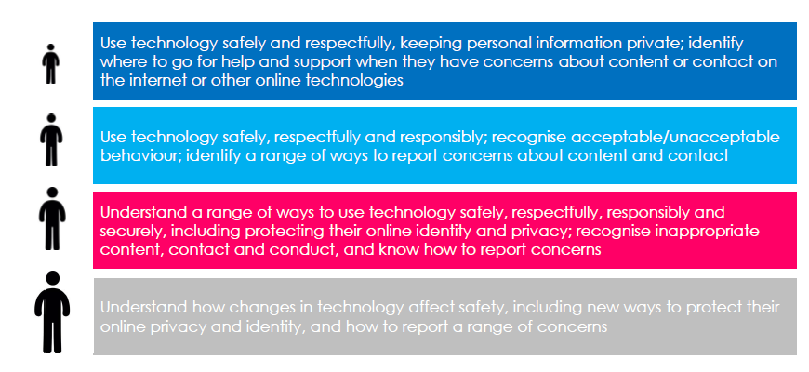
What are children taught in school
https://www.thinkuknow.co.uk/

Slide 24
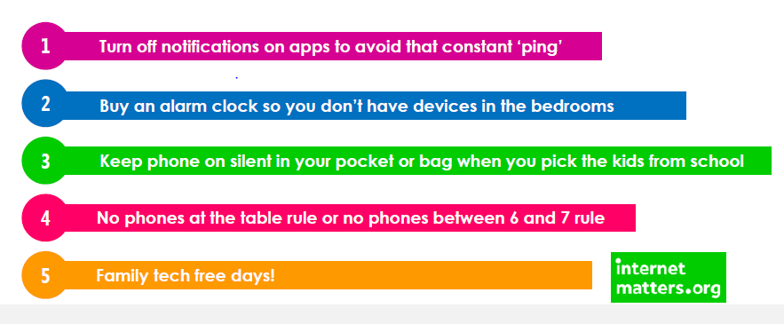
Controlling Tech Time

Slide 25
Controlling Tech Time
And there are tactics you can put in place to help manage their screen time….
1.Set a good example
2.Talk together about the time spent online
3.Agree on appropriate length of time they can use their device
4.Get the whole family to unplug & create screen free zones
5.Use technology / apps to help manage screen time e.g. Forest App

Slide 26

Learn how to use privacy settings
Become familiar with the websites your child visits.
Read privacy policies.
Settings should be “private.”

Slide 27
Basic ways to keep your child safe
Sign an “Internet Safety Contract.”
Keep the computer in a public area
of your home.
Set a time limit for computer use.
Become familiar with the sites your child visits.
Know your child’s online “friends.”
Know your child’s passwords.
Keep your security software up to date.

Slide 28
Basic online rules for children……
Never give out identifying information.
Never write or post anything you wouldn’t be comfortable with the whole world seeing.
Treat others online as you would treat them in person.
Never share your password.
Never open an email or click on a link from someone you don’t know.
Never download or click on anything without checking with me or another trusted adult first.

Slide 29

Helping Parents keep their children safe online
http://parentinfo.org/

Slide 30
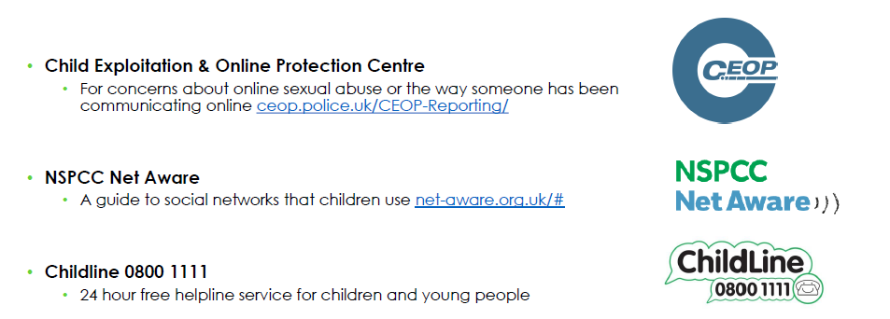
Other useful support services

Slide 31
Summary Top Tips
https://www.youtube.com/watch?v=sz4EyUMUTro

Slide 32
https://www.independent.co.uk/news/uk/home-news/facebook-fraud-risk-personal-information-like-page-data-to-go-short-film-a7120061.html

